Slide 2
Autodesk Inventor Tips and Tricks for New Users
Jill Conlin, PLTW Teacher
College Station High School
College Station, TX

Slide 3
Contact Information
Email: jconlin@csisd.org
Website: jconlin.weebly.com

Slide 4
Downloading T9 Files
Download the T9 assembly
Mypltw.org
IED Teacher file
Course Recourses
Automoblox T9 Files

Slide 5
Tips for Using the Main Menu
Customizing Standard Ribbon
Right Click
Show Panels
Select the panel to be added
Reverse Mouse Wheel Zoom Function
Tools
Applications option
Display
Zoom Behavior, Click Reverse Direction

Slide 6
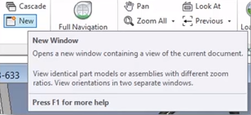
Tips for Working with Part Files
Change Part Orientation
Rotate to the view you want as Front
Right click on View Cube
Set Current View As
Front
Precision Zooming
Hold F3 to zoom in and out very small amounts
Using Multiple Windows for One Part/ Assembly
View
New
Tile Vertically

Slide 7
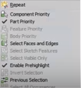
Tips for Working with Assembly Files
Visibility Shortcut (in Assembly)
In the tree, Right Click on the part
Type “V”
Copying Parts with a Drag/ Drop Method
Find part/ subassembly in the tree
Hold Control key and drag out from the tree
Selection Priority Tool
Shift, Right Click
Part Priority
Remove Appearance Overrides
In the tree, Right Click Default
Remove Appearance Overrides

Slide 8
Tips for Working with Drawing Files
View Creation, Activate First
To create a drawing of a part when multiples are open, click on the part file tab
Create Base View, now your part will automatically show in the View Creation
Control Key for Section View
Click on Section View
Pick the View
Draw section line, Continue
Hit Control key and now it will move out of alignment

Slide 9
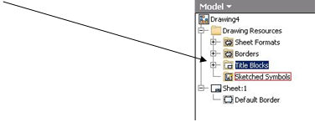
Creating a Custom Title Block
Open a new Drawing file (Standard.dwg).
Change the paper size by right clicking on Sheet 1 in the Browser, left clicking on Edit Sheet, selecting A under Size, and clicking OK.
Right click on the ANSI Large title block and delete.
Navigate to Title Blocks by clicking the + next to the Drawing Resources folder in the browser. Right click on Title Blocks and select Define New Title Block.

Slide 10
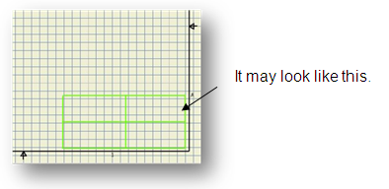
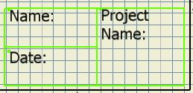
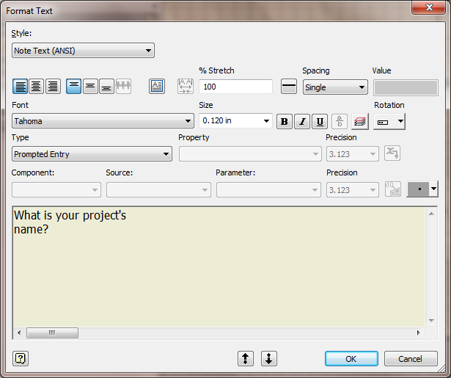
Creating a Custom Title Block Cont.
Now use sketching tools (rectangle, line, etc.) to create outlines of how you want the title block sections to look
Use the text tool to place text in your title block.
To create permanent text, left click to locate top left corner of the text. Type in the text desired. Highlight the text in order to change font size, bold, etc. Select OK.
To create Prompted Entry text, left click to locate top left corner of the text. Under Type, select Prompted Entry. Replace the text that says Enter Prompt for Field with your prompt. Highlight your prompt to change font size, etc. Click OK when done
To use field text (automatic info), left click to locate top left corner of the text. Under Type, select the property you want to use, and then click the Add Text Parameter button. Do not edit the text in the text box. Highlight text to change font, bold, etc. Click OK.

Slide 11
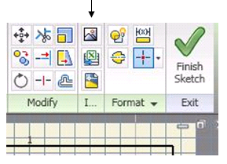
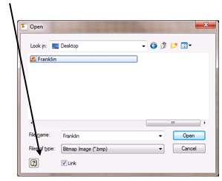
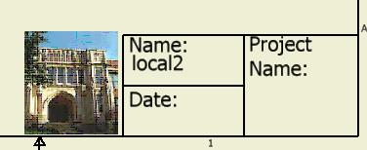
Creating a Custom Title Block Cont.
To insert an image, make sure your image is a bitmap. From Insert panel select Insert Image (icon that looks like a mountain). Left click to locate image and bring up Open pop up. Make sure to uncheck Link in the open window, or you will have to include any images that you use in the Templates folder.
When done creating/editing your block, right click and Save Title Block.
In your browser double click on the block that you have created. This action will apply the block to your drawing. If prompted entry appears, hit Cancel.

Slide 12
Creating a Custom Title Block Cont.
Save As and then choose Save Copy As Template. Save file in Inventor Templates folder OR have students save this template on their network drive space. This can now be opened and used as their template for any drawing file they create. If you wish to create a new tab in the New File box, create a new folder within the Templates folder. Save any items that you want to include in that folder.

Slide 13
Recap & Questions?
Email: jconlin@csisd.org
Website: jconlin.weebly.com

